Slide 1

Universal Apps – Your modern app on every windows device
Itay Shakury
Senior consulting architect
Microsoft Israel

Slide 2

One Windows
We are on a path to convergence across PC, Tablet, Phone and XBOX
Windows is the platform
…and we’re accelerating

Slide 3
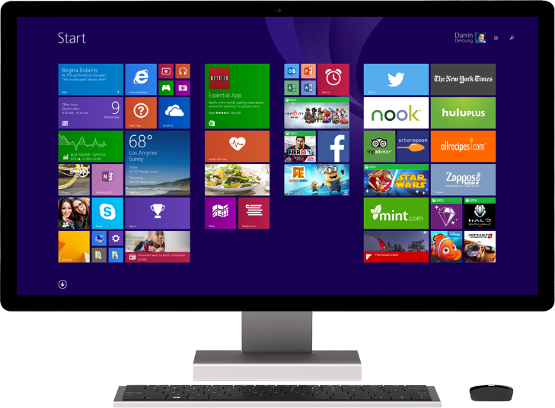
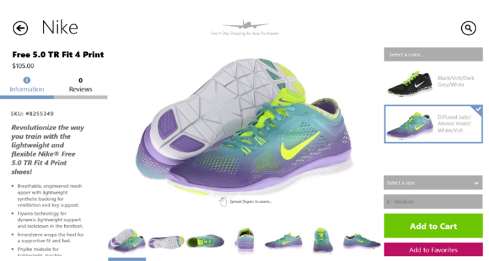
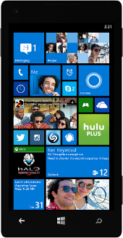
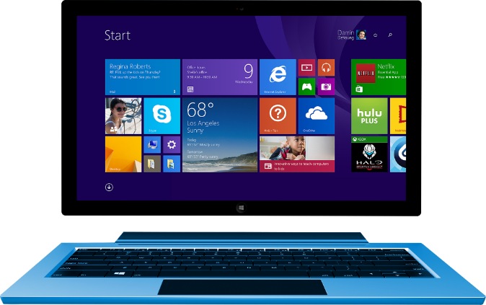
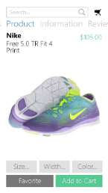

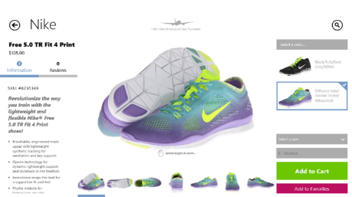
Introducing universal Windows apps

Slide 4
Universal Apps – Your modern app on every windows device
Itay Shakury
Senior consulting architect
Microsoft Israel

Slide 5

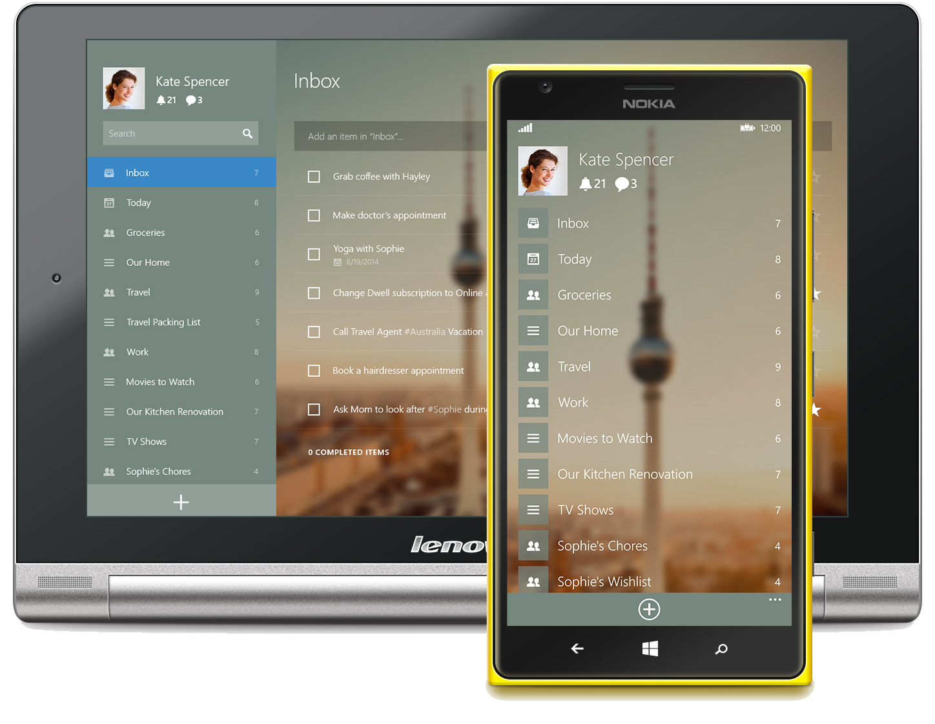

Slide 6
Streamlined end-to-end development
User Interface
App Model
APIs
Tools
Store

Slide 7
Develop your app in a way that’s familiar
User Interface
App Model
APIs
Tools
Store
C# / VB
XAML
C / C++
HTML / CSS
DirectX
JavaScript
Windows Runtime (WinRT)
Windows Kernel Services

Slide 8




Bring your own stack
Since it’s basically web development, you can actually use you favorite client side libraries and frameworks for building Universal Apps

Slide 9
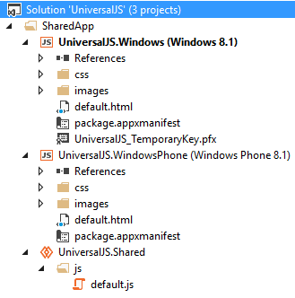
The Shared Project
User Interface
App Model
APIs
Tools
Store
Windows
Windows Phone
Shared code

Slide 10
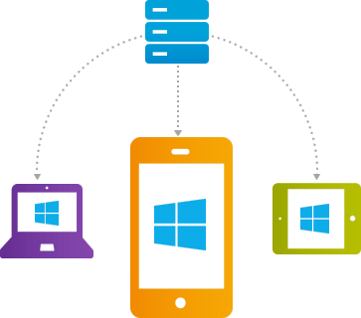
To share or not to share?

Slide 11
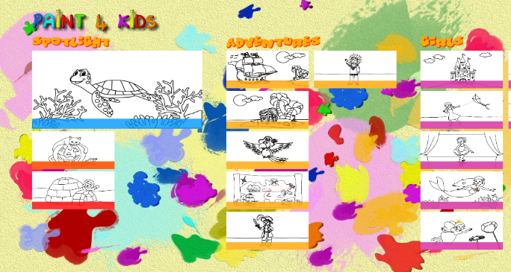





You can adapt one design across devices
User Interface
App Model
APIs
Tools
Store

Slide 12



You can tailor the design to each device
User Interface
App Model
APIs
Tools
Store

Slide 13
What do you want to share today?
Unique
CSS
HTML
JavaScript
Common

Slide 14
Demo
Meditation by Don Smith

Slide 15
There’s more…
App model
Winjs UI
Controls
Lifecycle
API
Ads SDK
Tiles
Notifications
PCL
Cross language
Visual Studio
Conditional compilation
Startup project selector
Context chooser for intellisense and error
Add to existing project
Debugging
Store
Pricing model
Developer Registration
App submission
In-app purchase
App linking
Name reservation

Slide 16
Microsoft Virtual Academy
http://www.microsoftvirtualacademy.com/training-courses/developing-universal-windows-apps-with-c-and-xaml
http://www.microsoftvirtualacademy.com/training-courses/developing-universal-windows-apps-with-html-and-javascript-jump-start
http://www.microsoftvirtualacademy.com/product-training/product-windows-store-apps

Slide 17
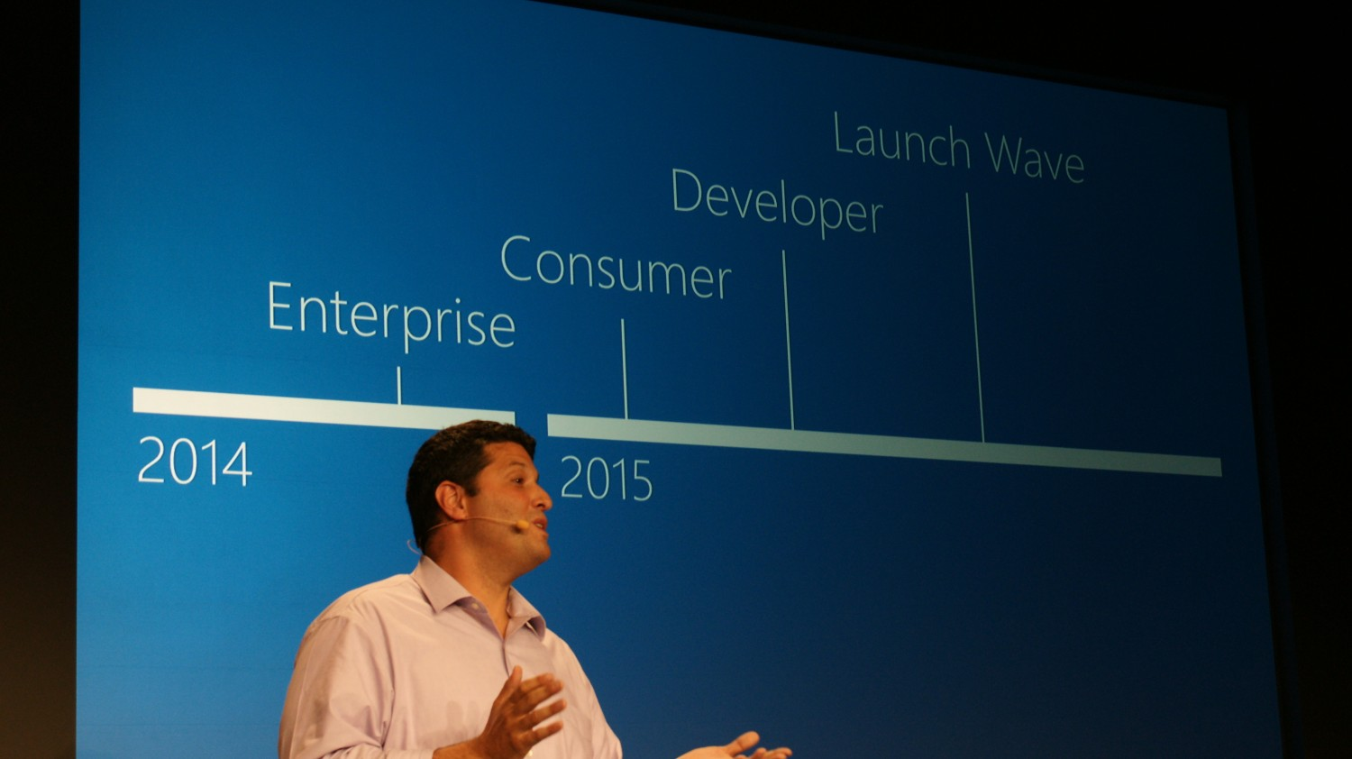

Slide 18
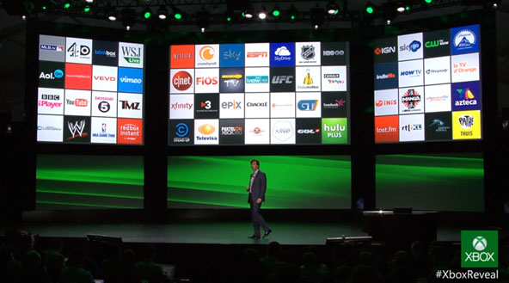
Notes:
http://channel9.msdn.com/Events/Build/2014/2-649

Slide 19
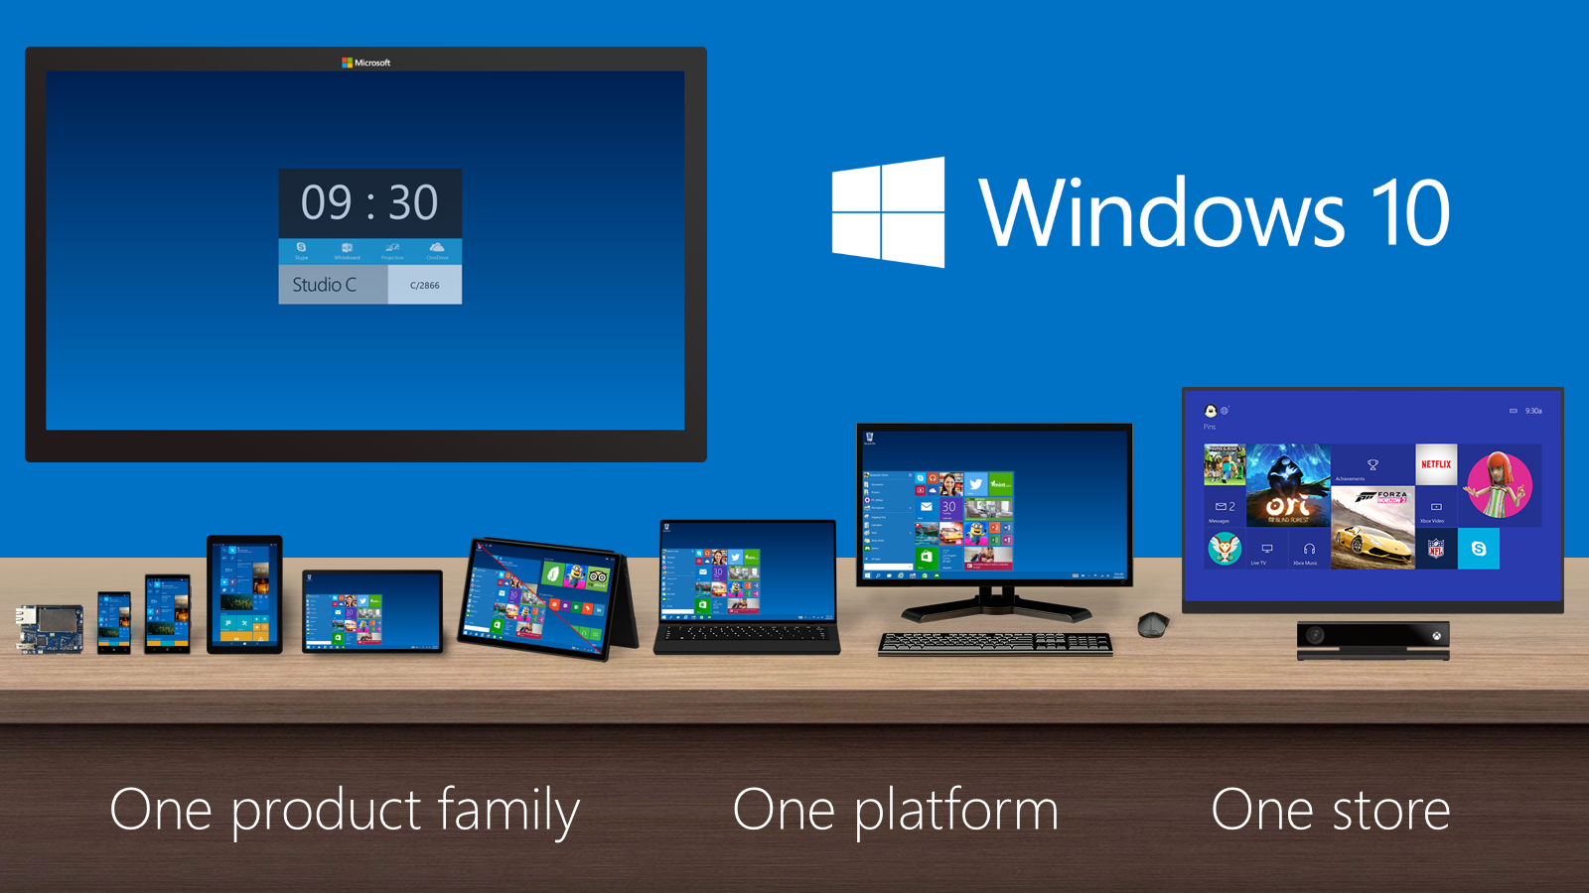

Slide 20
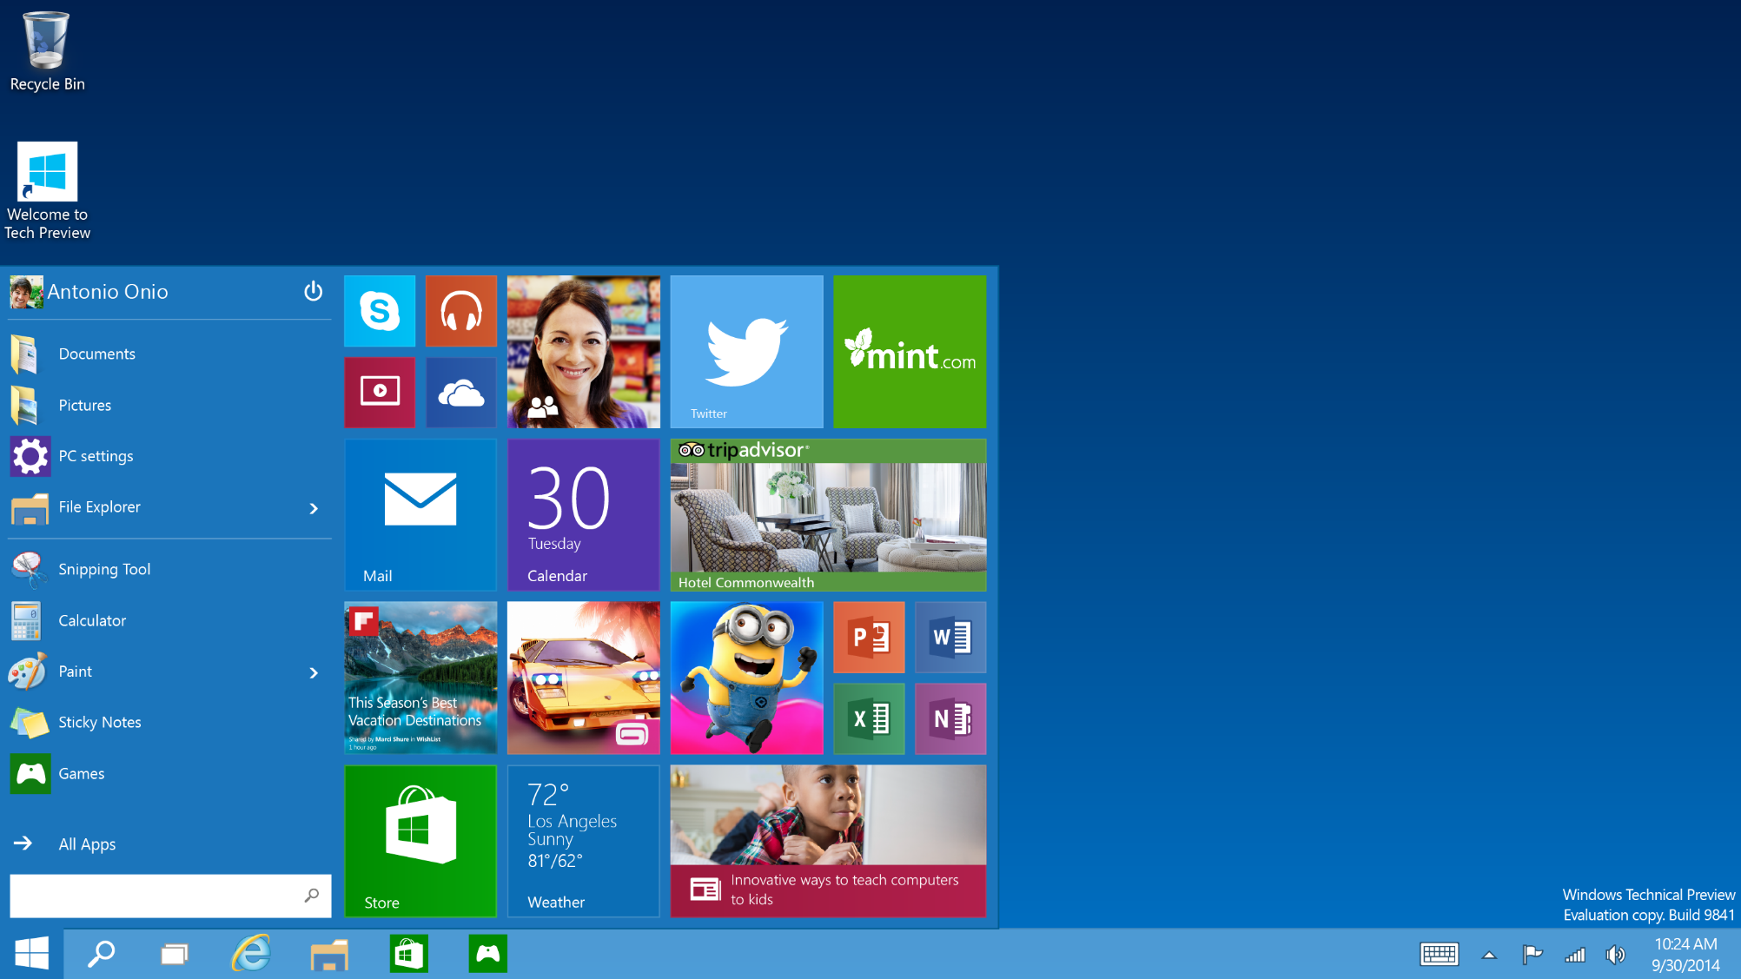

Slide 21
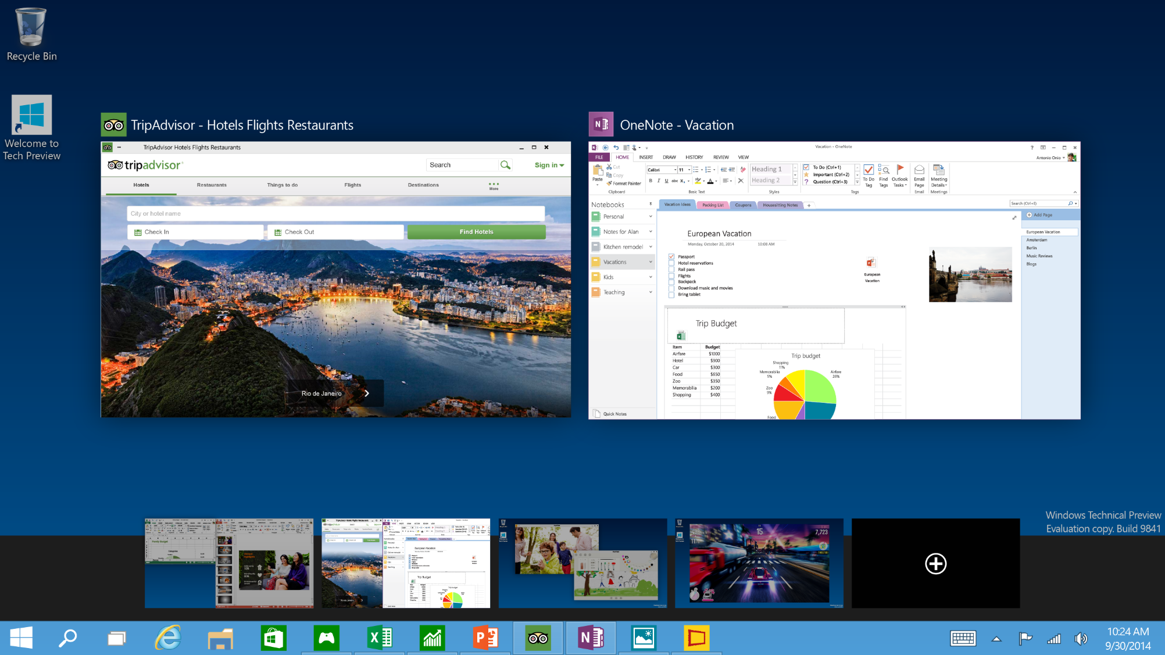

Slide 22
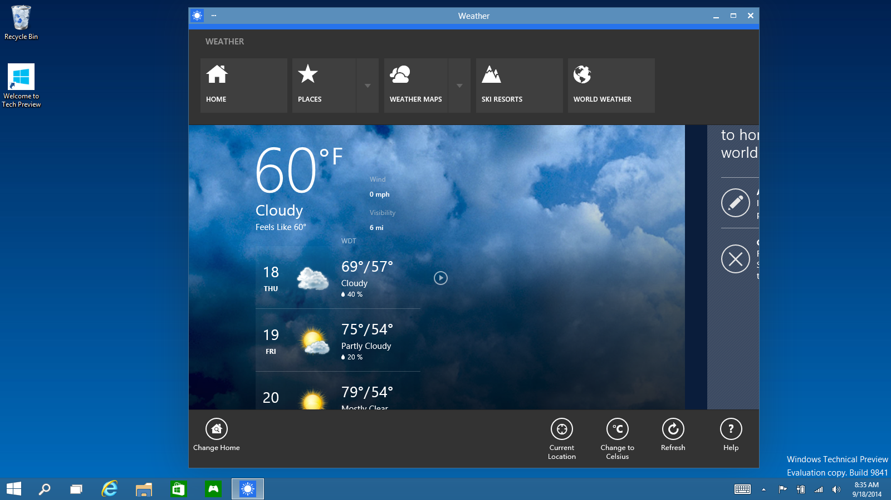

Slide 23

Summary
Windows is converging
Universal Apps are here now
It‘s easy to get started
Universal Apps are the future of app development
The ball is in your court!

Slide 24

Itay Shakury
Senior consulting architect
Microsoft Israel

